Slide 1

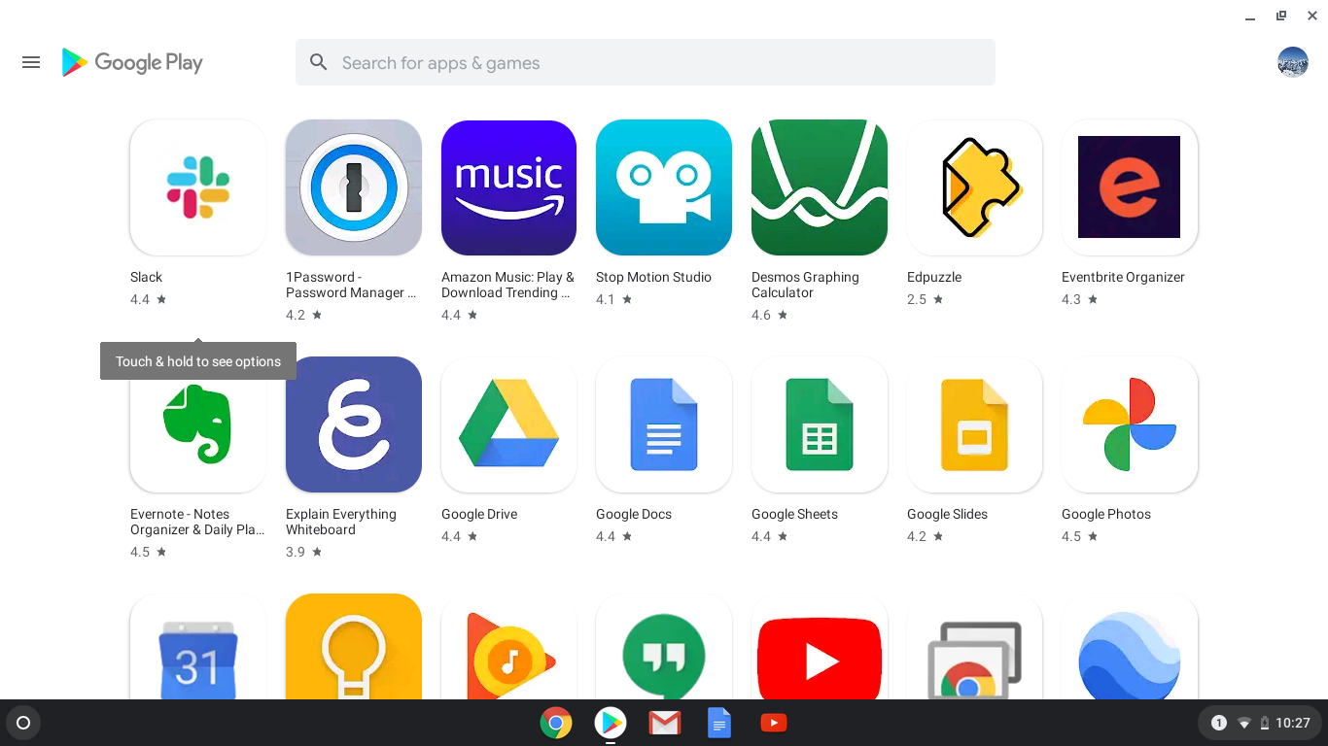

Google Play Store Apps: Analysis & Prediction
Shabna Nasser, M.Tech
Mentor: Upon Malik
Data Science Intensive Capstone Project
Feb 2024

Slide 2
Exploring App Domains
Mobile applications play a pivotal role in our daily lives, offering a variety of services ranging from communication and entertainment to productivity and health.
With millions of apps available on platforms like the Google Play Store, understanding app trends and predicting their success has become increasingly important for developers, marketers, and consumers alike.
Our project focuses on analyzing and predicting the performance of apps on the Google Play Store.
By leveraging data-driven insights and machine learning techniques, aim to uncover patterns, trends, and factors that influence an app's popularity and user rating.

Slide 3
Problem
With the exponential growth of mobile applications in the Google Play Store, there's a growing need to understand the factors influencing app success and user ratings.
This project aims to analyze and predict app ratings in the Google Play Store based on various features such as app category, price, size, user interaction metrics, and more.
Develops a predictive model that considers both app-specific features from the Google Play Store dataset and broader market indicators from the Google Stock Market dataset to forecast the app ratings accurately.
Goal: A comprehensive analysis of Google Play Store apps and develop a predictive model for rating prediction.

Slide 4

Data Overview
For this project, merges two distinct datasets, combining information from the Google Play Store Apps dataset and the Google stock market dataset.
The datasets utilized were procured from Kaggle:
Google Play Store Apps Dataset: Provides information about various mobile applications available on the Google Play Store. Includes attributes such as app name, category, ratings, number of installs, price, and more.
Google Stock Market Dataset: This offers market indicators and stock-related information from the Google stock market. Contains attributes such as stock prices, trading volumes, and other market metrics.
By merging these datasets, we explore potential relationships between the performance of apps on the Play Store and Google's stock market data.

Slide 5
Data Wrangling
The first step in our project is to merge the two datasets effectively.
Merging these datasets will create a unified dataset that combines both sets of information, allow us to analyze the relationship between app ratings and stock market indicators.
Cleaned each dataset separately.
Checked for null values and duplicates, fixed nulls, dropped unwanted columns.
Ensured that the data types of variables are appropriate for analysis and modeling.

Slide 6
Contd..
Merged them into a single dataframe.
Created correlation matrix between relevant variables in the merged dataset to understand the strength and direction of their relationships.
Made the datasets ready for exploratory analysis.
Finally, got a dataset with 1483784 rows and 22 columns.

Slide 7
Overall Representation of The Dataset
Entire Dataset
Google Play Store Apps
Released, App Name, Category, Rating, Rating Count, Installs, Minimum Installs, Maximum Installs, Price, Size, Last Updated, Content Rating, Ad Supported, In App Purchases, Editors Choice, Type
Google Stock Market
Date Open High Low Close Volume
Final Data
Merge on Date columns

Slide 8
Feature Engineering
Created new features by combining existing features through mathematical operations.
Interaction Features
This can be derived by multiplying the rating count with the interaction rating volume.
Interactions between different app characteristics and stock market indicators, that may have a collective influence on app ratings.
'Interaction_Rating_Volume' feature reflects the interaction or joint influence of the number of ratings and the trading volume.
This interaction feature might be useful to know how the impact of ratings on the app's performance in the stock market is related to the trading volume.

Slide 9
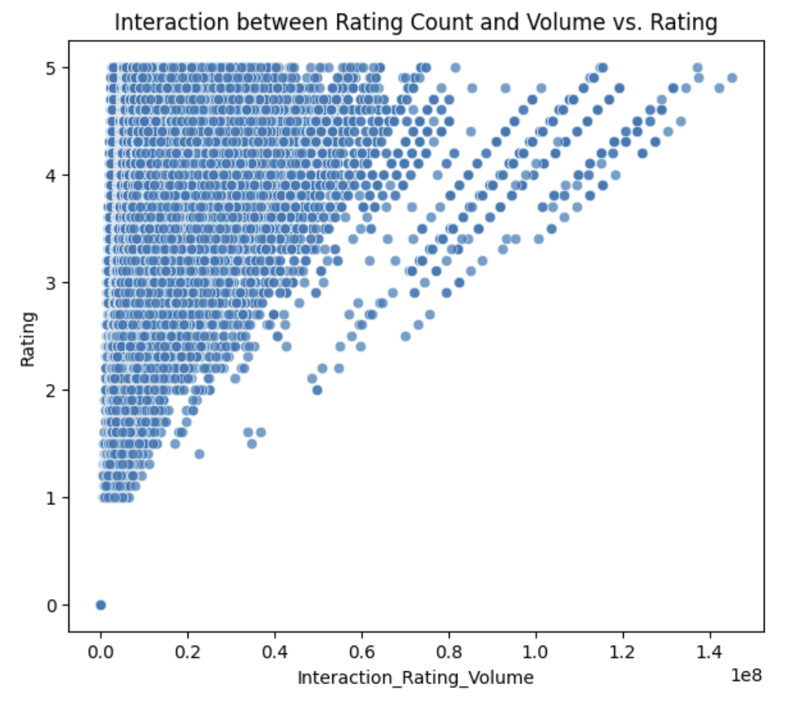
Contd..
Plot suggests a potential relationship between the interaction feature and the app ratings.
Positive trends indicate that higher values of the interaction feature are associated with higher ratings, and vice versa.
It suggests that apps with more user engagement tend to receive better ratings from users.
This could imply that users are more likely to rate an app positively if they perceive it as engaging, useful, or valuable.

Slide 10
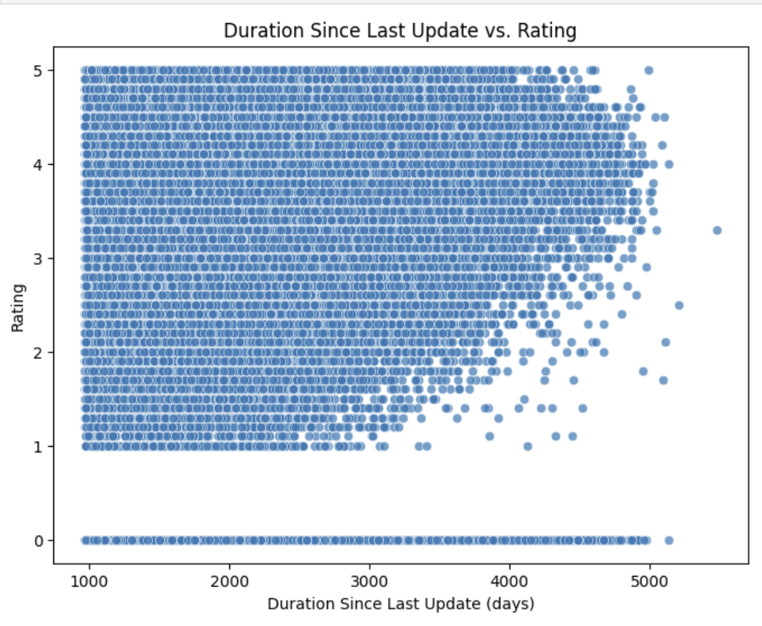
Duration Since Last Update:
Calculated the duration since the last update of each app, based on the 'Last Updated' column.
This feature represents the recency of app updates.
Investigate whether more recently updated apps tend to have higher ratings.
Plot visualizes the relationship between the duration since the last update and the app ratings.
Each point on the plot represents an app.
If the updates are more frequent or if the duration is less then there is a chance for higher rating.

Slide 11
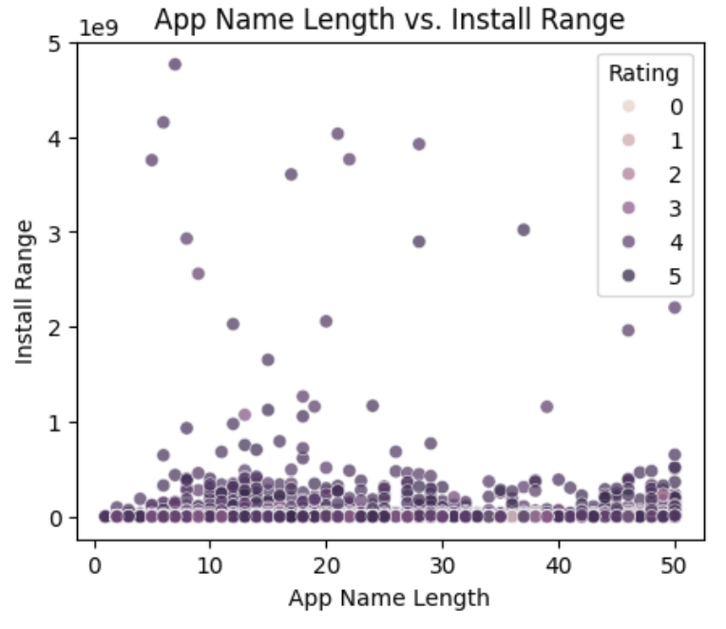
App Name Length:
Determined the length of each app's name as a feature.
This feature quantifies the complexity or informativeness of app names.
Install range is almost same or a lighter effect for most of the apps with different app name lengths and a very few of them are with high install range and rating with short app name length.
From this we can say that Install range and rating is higher for apps with short app name length.
This feature would help in rating prediction.

Slide 12
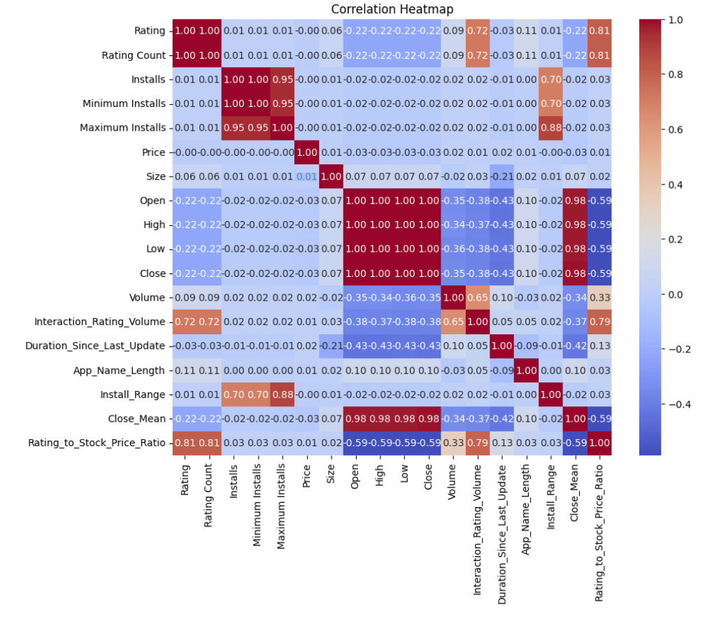
Data Exploration
Heat Map
Here, we can see some features have positive correlations.
Like Rating_to_Stock_Price_Ratio, rating count and ineraction_rating_volume are correlated.

Slide 13
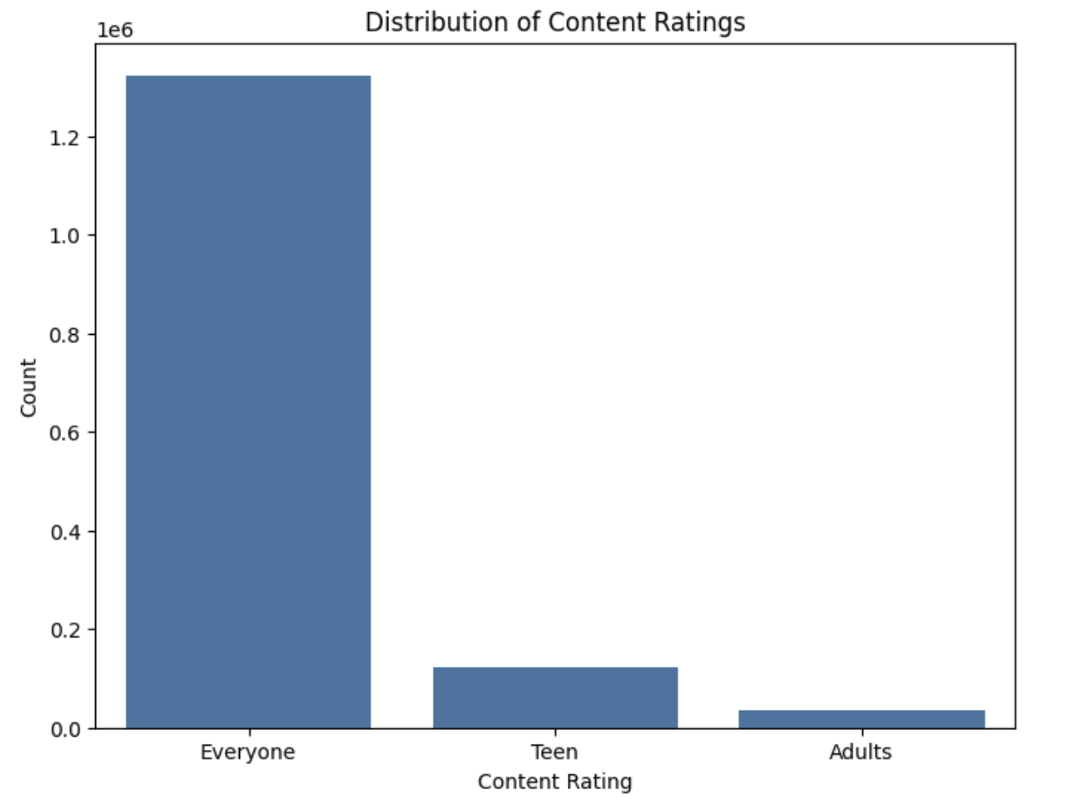
Distribution of content rating
Shows that teens contribute to content rating than that of adults.
Apps rated for teens may often include high-quality content, such as educational resources, creative tools, or entertainment options, which receive positive feedback from users. The perceived value and enjoyment derived from these apps contribute to higher ratings.
Teenagers may be more active and engaged users of mobile apps compared to adults, leading to increased usage, interactions, and ratings.
Higher user engagement levels can positively influence app ratings.

Slide 14
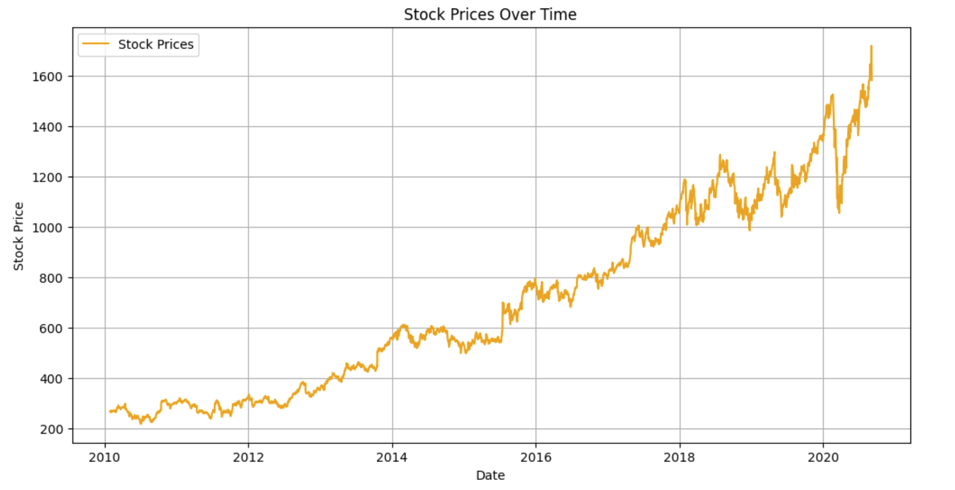
Stock Prices Over Time
The line plot visualizes the historical trend of stock prices over time.
Each point on the plot represents the closing price of the stock.
In this plot, the line generally slopes upwards, indicating that the stock prices tend to increase over the observed period.
This upward trend suggests positive growth or appreciation in the value of the stocks.

Slide 15
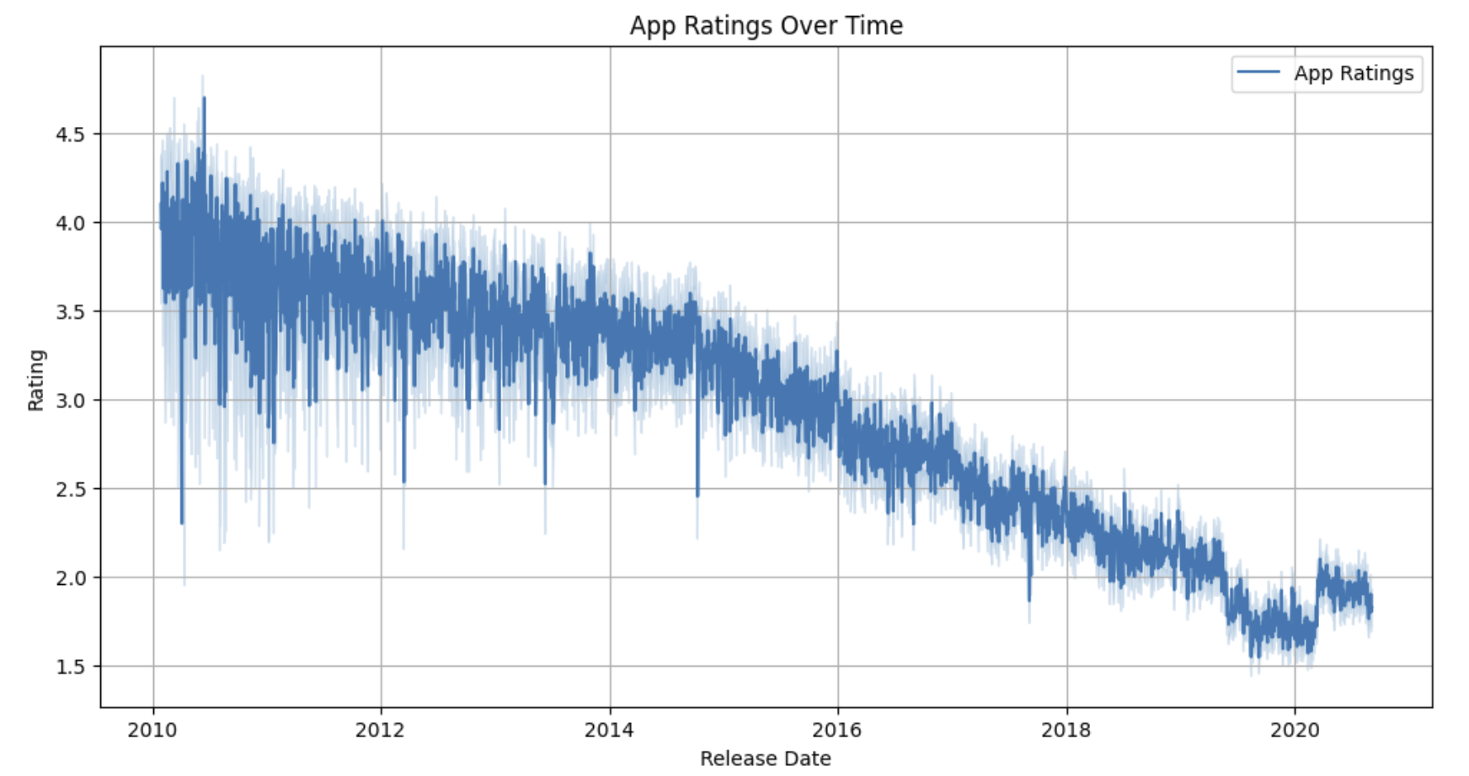
App Ratings Over Time
Checked how App Ratings changes over time.
In this plot, the line generally slopes downwards, indicating that the app ratings tend to decrease over the observed period.
This downward trend suggests a decline in the overall user satisfaction or perceived quality of the apps released over time.
The decreasing trend in app ratings suggests that the apps released over time have received lower ratings from users compared to earlier releases.
This may be due to various factors such as declining app quality, increased competition, changes in user preferences, or shifts in market dynamics

Slide 16
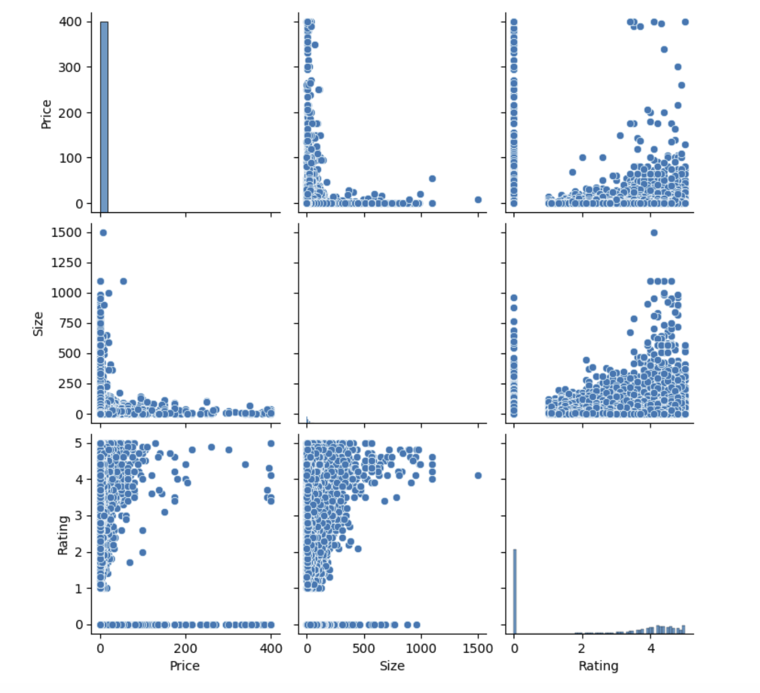
Pairplots: Price, Size, and Rating
From this plot we can say that, when size increases, the price and rating decreases.
As the size of an app increases, there may be a tendency for developers to offer it at a lower price or even for free.
This could be due to various factors, such as increased competition in the market, users' reluctance to pay higher prices for larger apps, or developers' strategies to attract more downloads by pricing larger apps lower.
Larger apps may suffer from performance issues, longer loading times, or higher resource consumption, which can negatively impact user experience and satisfaction, leading to lower ratings.
Also, Rating is higher for lower priced apps comparatively.

Slide 17
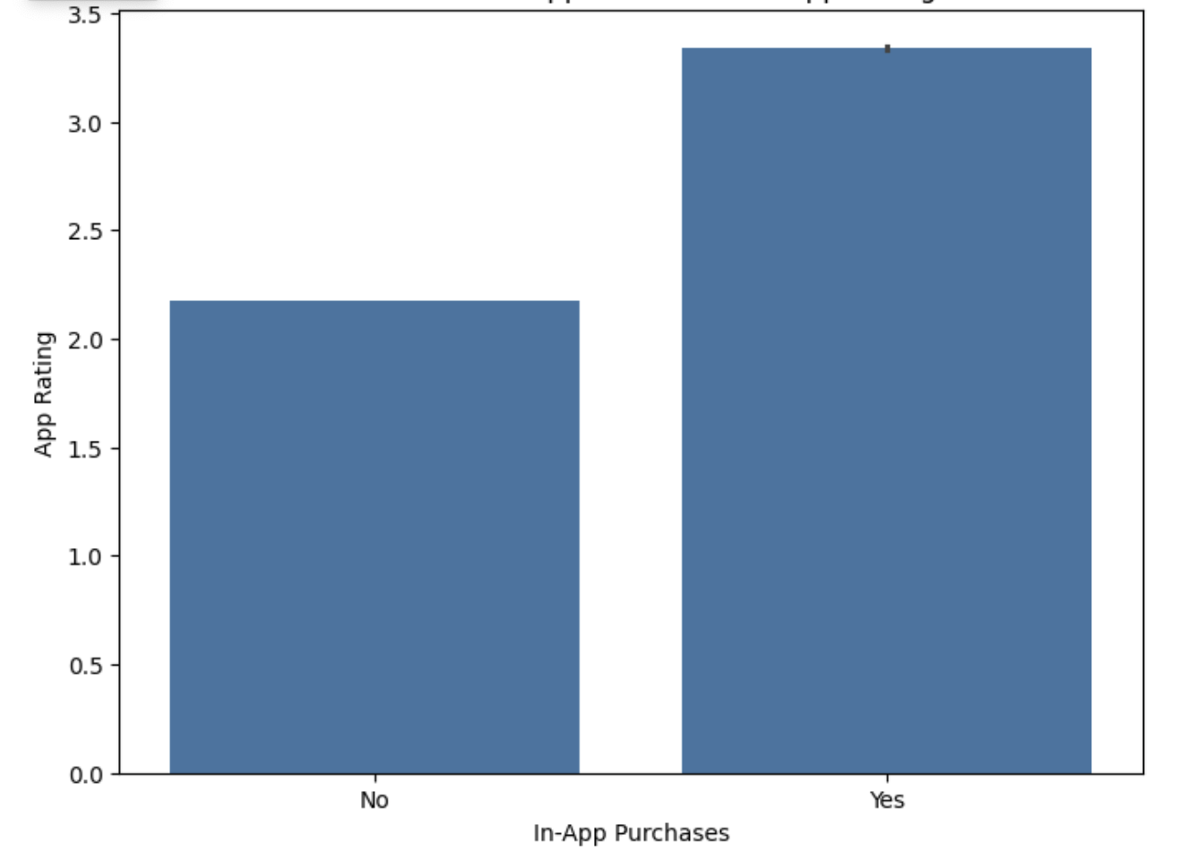
Presence of In App Purchases Vs App Rating
If the presence of in-app purchases is Yes, it seems to correlate with higher app ratings compared to apps without in-app purchases.
This suggests that users may perceive apps with in-app purchases as providing more value or offering better features, leading to higher ratings.
Also, we can say that incorporating in-app purchases into their apps could potentially lead to higher user satisfaction and better ratings.

Slide 18
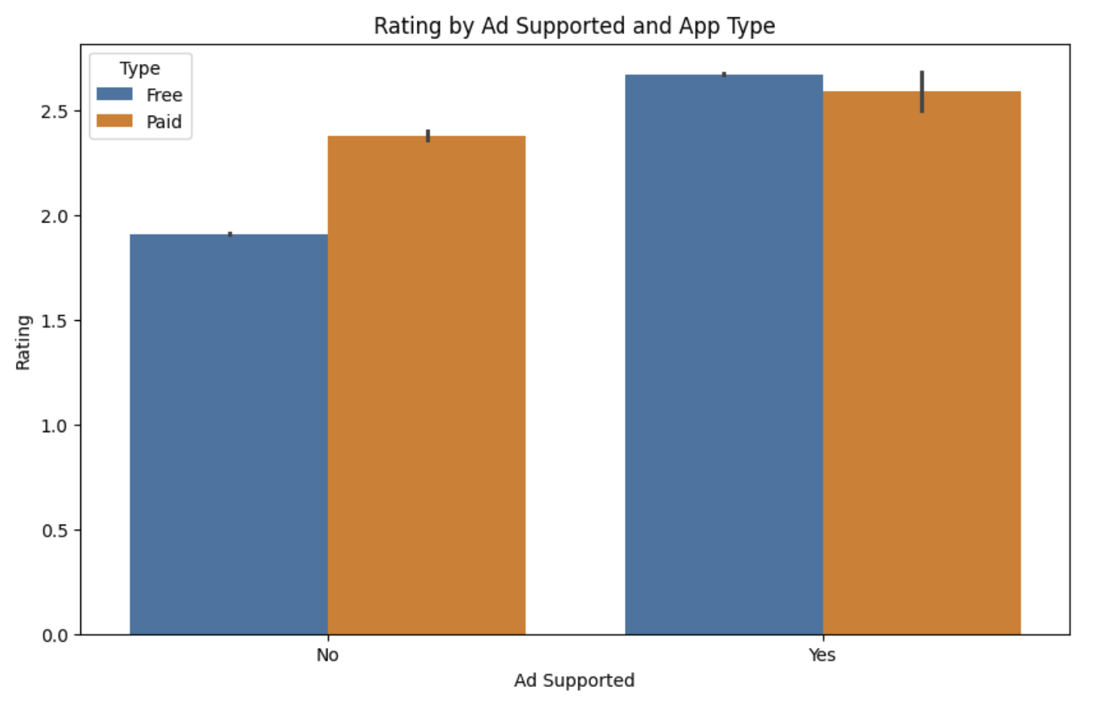
Rating by Ad Supported and App Type
Plot provides insights into how the ad-supported status and app type can influence user ratings.
Ad-supported free apps tend to have higher ratings compared to other categories.
This may indicate that users are more inclined to rate apps positively if they are provided for free and supported by ads.
Apps that are not ad-supported and require payment (Paid) have slightly higher ratings compared to free apps without ads.
This could imply that users who pay for apps have higher expectations and may be more critical in their ratings.

Slide 19
Modeling
Make predictions using holdout dataset (20% of the whole data).
Performance comparison & feature importance checks.
Data Preprocessing Steps: One-hot encode categorical features using pandas get_dummies. Split the dataset into training and testing sets (80-20 split). Standardize the magnitude of numeric features using a scaler (StandardScaler).
Cross Validation (CV) for hyperparameter tuning: 5 Fold CV. Using sklearn cross_val_score method.
Training models using 80% of the whole data. Evaluation metric: MSE, MAE, MedAE, R-squared
Testing

Slide 20
Classification Algorithms Used
1) Random Forest
This combines multiple decision trees to improve predictive accuracy and control overfitting.
Builds a multitude of decision trees and merges their predictions.
2) Gradient Boosting Regressor
Gradient Boosting builds trees sequentially, focusing on correcting errors made by previous models.
This iterative process often leads to improved performance and is suitable for complex regression tasks.
3) XGB Regressor
It is an implementation of gradient boosting that is highly optimized for speed and performance
It includes built-in regularization techniques to prevent overfitting and improve generalization.
Handle large datasets and is widely used in industry for its efficiency and scalability

Slide 21
Evaluation Metrics:
Mean Squared Error (MSE): The average of the squared differences between the predicted values and the actual values.
Mean Absolute Error (MAE): The average absolute difference between the predicted values and the actual values.
Median Absolute Error (MedAE): The median of the absolute differences between the predicted values and the actual values.
R-squared (R2): The proportion of the variance in the dependent variable (target) that is explained by the independent variables (features) in the model.

Slide 22
Model Comparison
Models | MSE | MAE | MedAE | R2
Random Forest Regressor | 0.300 | 0.367 | 0.245 | 0.697
Gradient Boosting Regressor | 0.307 | 0.392 | 0.275 | 0.690
XGB Regressor | 0.363 | 0.399 | 0.224 | 0.633
Best performing model among these models is Random Forest Regressor with an R-squared: 0.697.

Slide 23
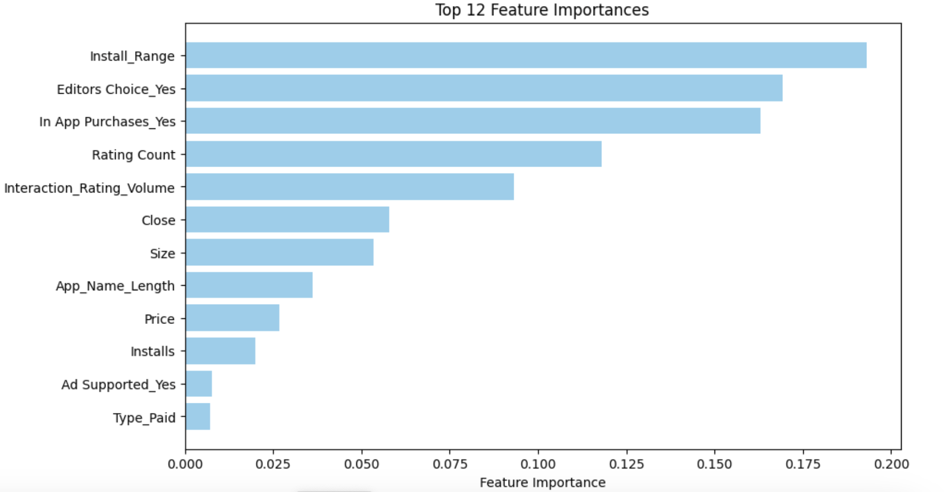
Feature Importance
The feature importances were calculated.
Bar chart to provide insights into the relative importance of each feature.
The top 12 features that exert the most influence on the model's predictions.
The features are Interaction_Rating_Volume,Install_Range, Editors Choice_Yes, In App Purchases_Yes, Rating Count, Interaction_Rating_Volume, Size, Price, etc.

Slide 24
Top Features
Install_Range: This feature likely represents a range of installation counts for the app. It could indicate the popularity or demand for the app. Apps with higher installation ranges might have more visibility or user engagement, potentially leading to higher ratings.
Editors Choice_Yes: This indicates whether the app has been selected as an Editor's Choice. Being chosen as an Editor's Choice can provide additional exposure and credibility for the app, which may positively influence user perception and ratings.
In App Purchases_Yes: This binary feature signifies whether the app offers in-app purchases. Apps with in-app purchases might provide additional content, features, or benefits to users, enhancing their overall experience and potentially leading to higher ratings.
Rating Count: This feature represents the total number of ratings received by the app. Higher rating counts indicate greater user feedback and engagement. Apps with a large number of ratings may be perceived as more established or trustworthy, influencing potential users and their ratings.

Slide 25
Contd..
Interaction_Rating_Volume: This feature could represent the volume or intensity of interactions (e.g., user reviews, comments, likes) related to the app. Higher interaction volumes might indicate greater user engagement or community activity, which could correlate with higher app ratings.
Size: This feature represents the size of the app in terms of storage space required for installation. While not directly related to app quality, smaller app sizes are generally preferred by users, as they consume less device storage and are quicker to download.
App_Name_Length: The length of the app name might indirectly influence ratings. Short, catchy names might be more memorable and easier to find in app stores, potentially leading to more downloads and higher ratings.
Price: The price of the app, if it's a paid app, can influence user perceptions of value. Users may have higher expectations for paid apps and thus provide more critical ratings compared to free apps.
Installs: This feature likely represents the total number of installations for the app. Higher installation numbers can signal popularity and trustworthiness, positively impacting user perceptions and ratings.

Slide 26
CONCLUSION
This project aimed to develop predictive models for app rating prediction by training and evaluating various machine learning algorithms on a dataset combining Google Play Store app characteristics and Google's stock market performance data.
Employed machine learning algorithms, Random Forest, Gradient boosting and XGB regression models.
Evaluated performance based on key metrics such as MSE, MAE, MedAE, R-Squared.
Random Forest Regression model performed best, demonstrating the best fit to the data among the models tested.
Feature importance analysis highlighted factors contributing to the model's decision-making process, providing valuable insights into the intricate patterns within the dataset.

